Slide 1



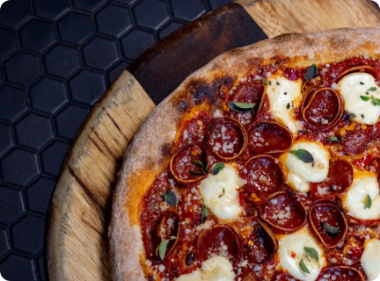

Pizza Hut Sales Analytics & Insights
An end-to-end relational database investigation using MySQL Workbench to analyze sales performance, order patterns, and top revenue drivers.
Data-Driven Revenue Optimization
Environment MySQL Workbench
Scope 13 Analytical Queries
Transforming Raw Data into Business Strategy

Slide 2






Project Architecture & Pipeline
1. Data Ingestion
2. SQL Execution
3. Executive Value
Normalized transactional pizza dataset transformed from flat files into MySQL structured tables.
Crafted robust queries categorized across three progressive difficulty tiers.
Extracted key operational metrics to guide inventory and marketing decisions.
4 Interconnected relational tables
Basic: Aggregations & Counts
Identify peak hourly rush periods
48,000+ transactional order records
Intermediate: Joins & Subqueries
Optimize pizza category stock
Clean primary & foreign key constraints
Advanced: CTEs & Window Functions
Maximize top-line revenue growth

Slide 3







Relational Database Schema
orders
order_details
order_id | INT (PK)
date | DATE
time | TIME
order_details_id | INT (PK)
order_id | INT (FK)
pizza_id | TEXT (FK)
quantity | INT
Database Architecture
Designed a highly normalized schema (3NF) to eliminate data redundancy and preserve transactional integrity across order processing.
The schema centers around transactional order logs linking order items directly to menu pricing and categorical metadata.
pizzas
pizza_types
TOTAL TABLES
PRIMARY KEYS
pizza_id | TEXT (PK)
pizza_type_id | TEXT (FK)
size | TEXT
price | DOUBLE
pizza_type_id | TEXT (PK)
name | TEXT
category | TEXT
ingredients | TEXT

Slide 4


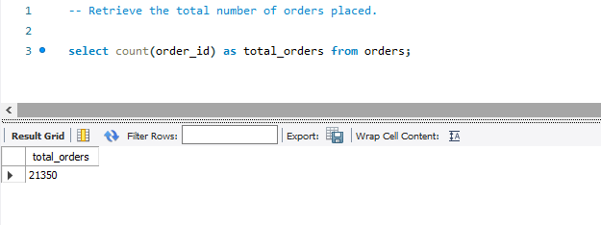
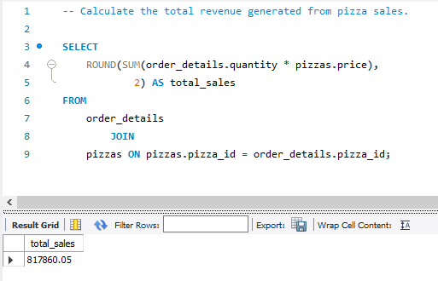
Basic Queries: Orders & Total Revenue
TOTAL ORDERS EXECUTED
Derived via SELECT COUNT(order_id) FROM orders;
TOTAL TOP-LINE REVENUE
Calculated by joining order_details & pizzas prices.

Slide 5


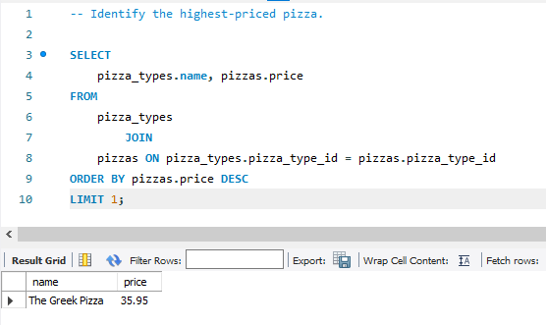

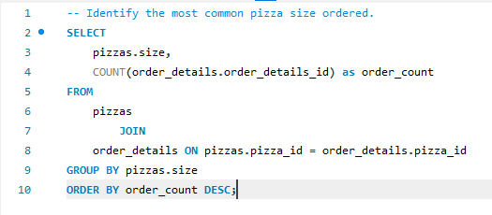

Basic Queries: Pricing & Size Demands
$35.95
Highest-Priced Pizza
Determined by ordering the pizzas database by price DESC with a limit of 1.
The Greek Pizza (XXL)
Commands the top price point on the menu, catering to large group orders and premium catering.
Large (L) Size
Most Common Size Ordered
Large (L)18,526 orders
Medium (M)15,385 orders
Small (S)14,137 orders

Slide 6


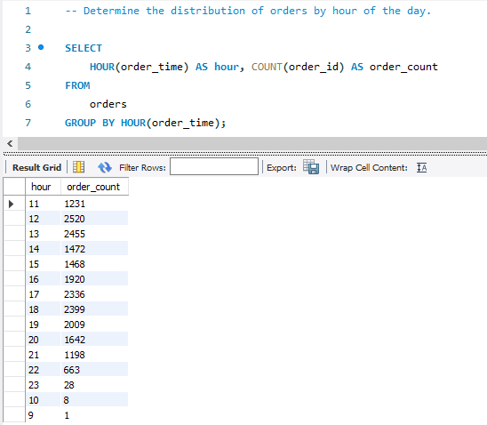

Intermediate Query: Peak Hourly Distribution
Orders Handled by Hour of Day
12:00 PM (Lunch Rush)2,520
01:00 PM2,260
05:00 PM2,270
06:00 PM (Dinner Rush)2,392
Hourly Order Rush Patterns
07:00 PM2,020
Extracted the hour component from order timestamps using HOUR(time) to identify critical operation peaks throughout the operating day.
Operational Rush Windows
Lunch Peak: 12:00 PM – 1:00 PM (2,520+ orders) Dinner Peak: 5:00 PM – 7:00 PM (2,390+ orders)
Optimizes kitchen prep schedules during transition hours
Guides shift staffing density for maximum throughput

Slide 7


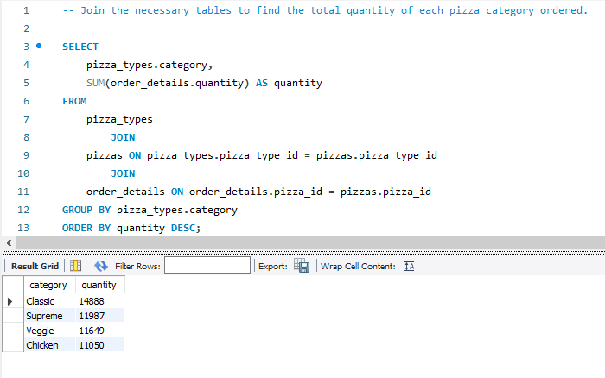
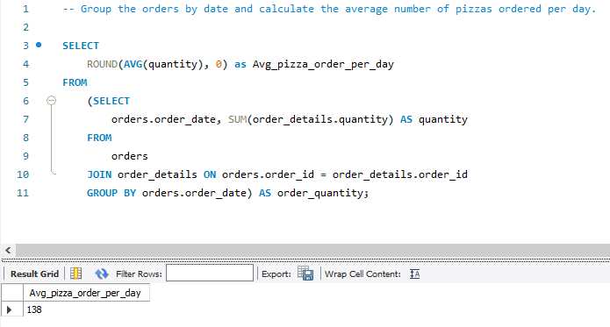


Category Volumes & Daily Average
Total Pizzas Sold by Category
Classic Category14,888 items
Supreme Category11,987 items
Veggie Category11,649 items
Chicken Category11,050 items
AVERAGE PIZZAS PREPARED PER DAY
Grouped by order date and averaged across the entire operating timeline.
Operational Insight
Classic pizzas lead volume by a wide margin, representing over 29% of total physical unit sales.

Slide 8


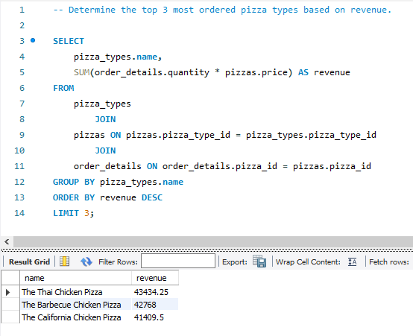

Query #10: Top 3 Revenue Champions
Query_10_Top3_Revenue_Pizzas.sql
Top 3 Pizzas by Revenue
Key Revenue Drivers
Aggregated total sales value by multiplying individual unit price with ordered quantities.
Rank | Pizza Name | Revenue ($)
#1 | The Thai Chicken Pizza | $43,434.25
#2 | The Barbecue Chicken Pizza | $42,768.00
#3 | The California Chicken Pizza | $41,409.50

Slide 9


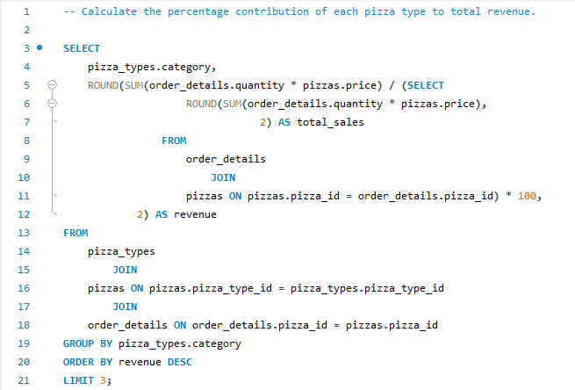


Query #11: Percentage Revenue Contribution
Category Revenue Contribution
Calculated the percentage share of each category relative to total overall revenue using nested subqueries.
Classic: 26.91% ($220,053)
Supreme: 25.46% ($208,197)
Chicken: 23.96% ($195,919)
Veggie: 23.68% ($193,690)

Slide 10

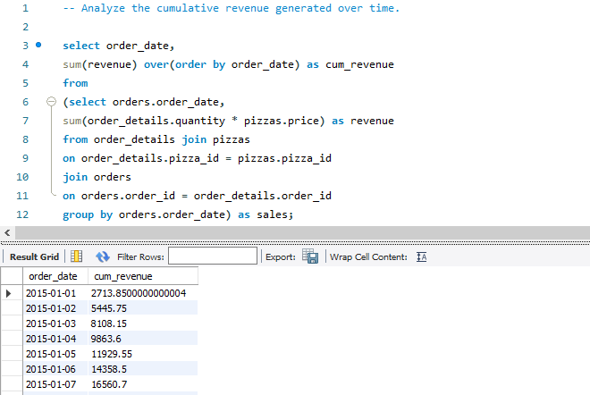

Query #12: Cumulative Sales Over Time
Running Total Tracking
Leveraged SQL Window Function SUM() OVER (ORDER BY date) to analyze running revenue velocity across consecutive order dates.
Revenue Acceleration
Demonstrates remarkably consistent day-over-day growth, proving stable demand throughout the entire annual timeline.

Slide 11

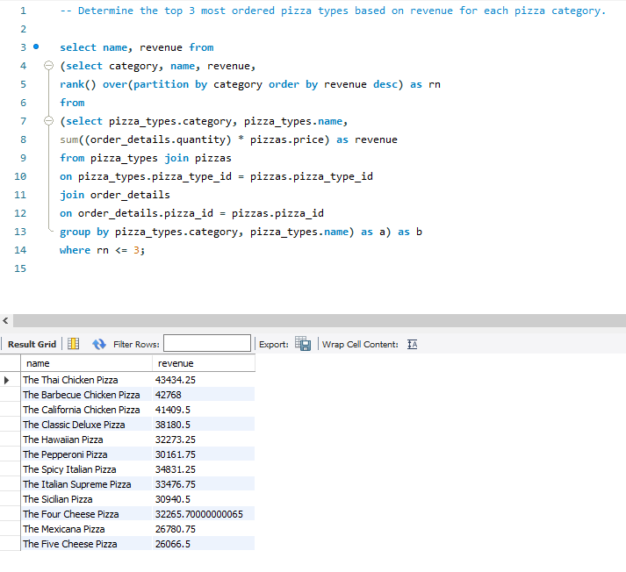

Query #13: Top 3 Pizzas per Category
Category Hero Products
Applied DENSE_RANK() OVER (PARTITION BY category ORDER BY revenue DESC) to rank revenue leaders within each specific category.
Identifies menu category champions without cannibalization
Isolates low-performing items for potential menu revisions

Slide 12




Executive Business Recommendations
1. Labor Scheduling
2. Inventory & Stock
3. Menu Strategy
Align shift capacity around key operational spikes:
Streamline ingredient purchasing toward high-demand items:
Optimize top-line growth with targeted marketing:
Scale staff during 12-1 PM lunch rush
Feature Chicken category combo upsells
Ensure double coverage during 5-7 PM dinner surge
Prioritize Large (L) box inventory
Re-evaluate lowest performing recipes
Maintain higher safety stock for Classic recipes

Slide 13

Questions & Discussion
Thank you for reviewing the Pizza Hut SQL Analytics Presentation. The database models and SQL scripts are fully verified and operational.
MySQL Workbench 8.0
13 Executed Queries
Analysis Complete

Slide 14
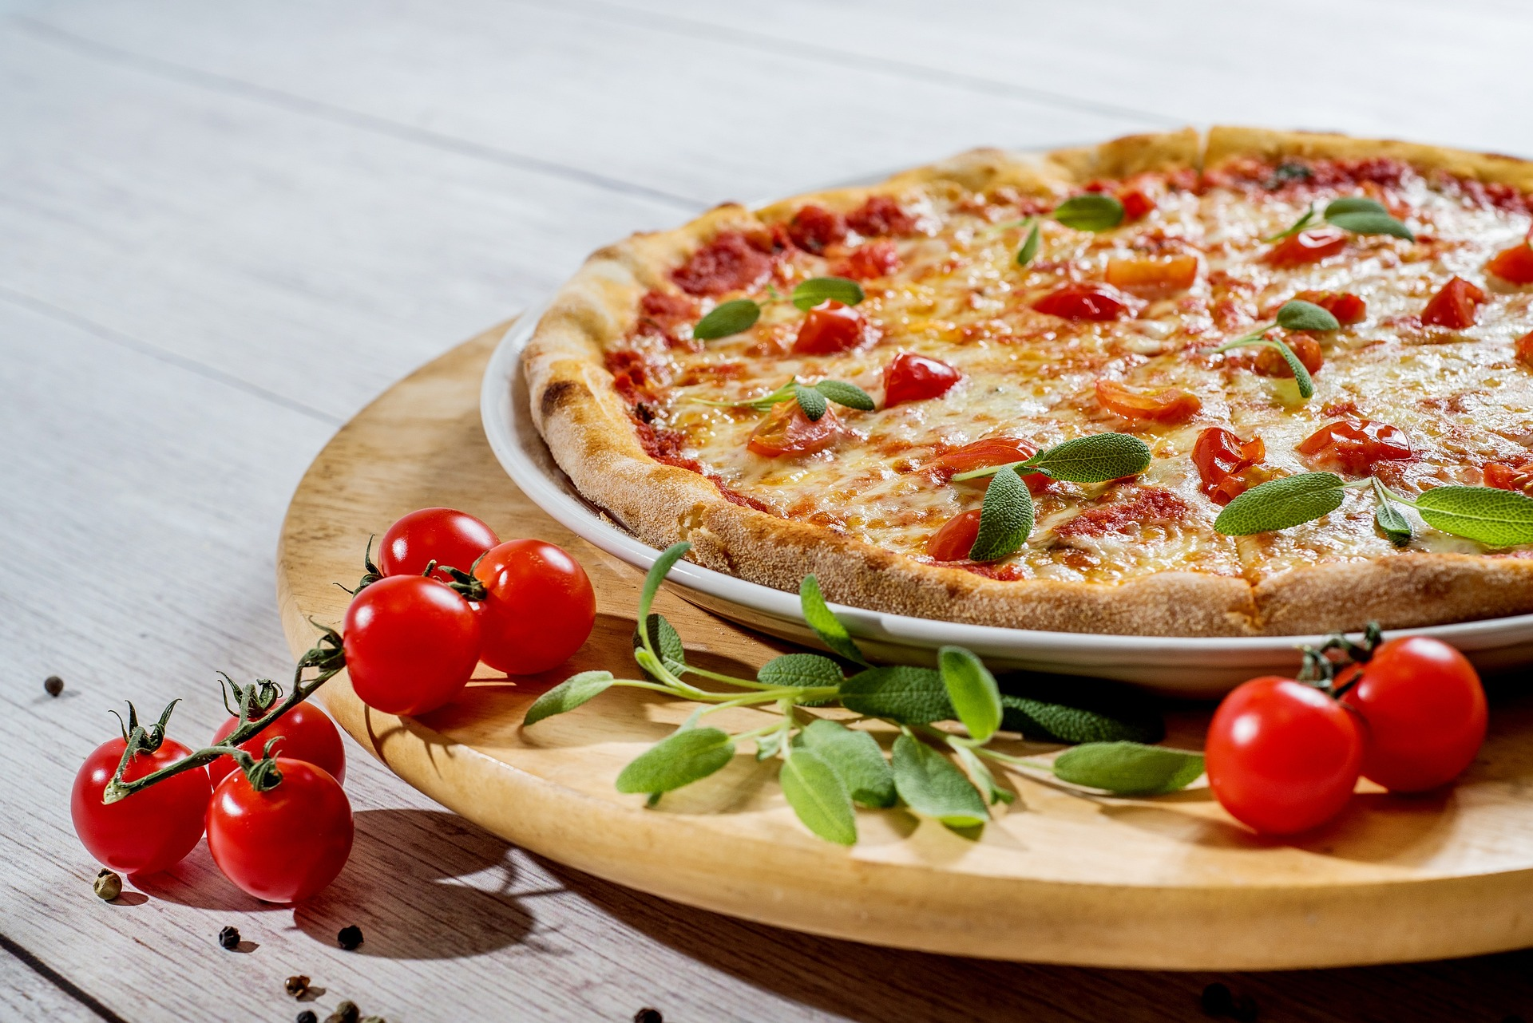
Image Sources
Thank You

